Slide 1
Team 5
Andrew Light
Nicci Hart
Olivia Zhang
Robert Hoyer
Will Plachno

Slide 2
Project Description
The program will allow the user to maintain a shopping list. The list will contain, in addition to the item name, the approximate cost of the item per unit, the preferred store to find the item, the quantity of the item needed, and the date the item is needed by.
Notes:
Rob

Slide 3
Data Record (ListItem)
name – The name of the item to be purchased, Key Value
cost – The approximate cost of the item.
store – The store where the item should be purchased.
quantity – The number of items to buy. (default 1)
date – The date by which the item should be purchased.
Notes:
Rob or Andrew (it says the team leader is “supposed” to, but would probably work better if I did)

Slide 4
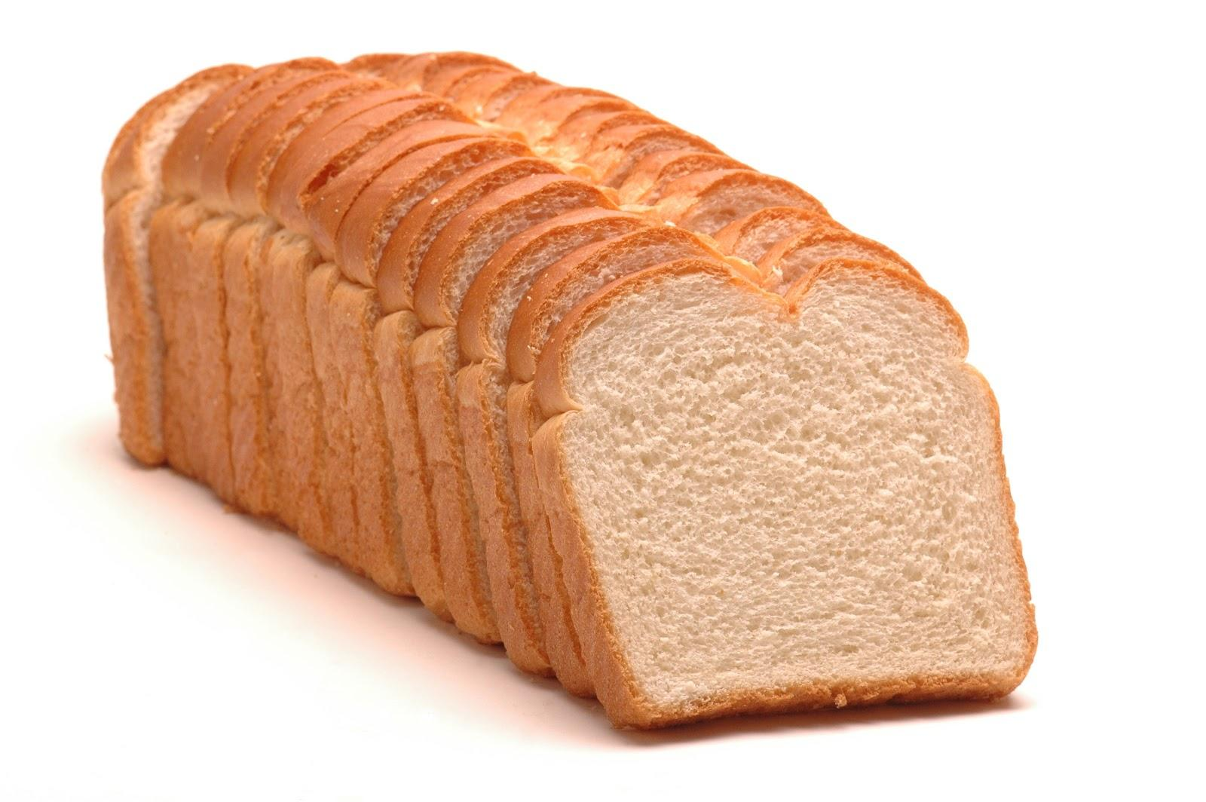
Bread
name – “Loaf of Bread”
cost – 2.37
store – “Safeway”
quantity – 1
date – “every two weeks”
OR “Jan 5, 2016”
“7/5/2015” etc.
Notes:
Andrew
most stuff self-explanatory, but date does not necessarily have to be any specific day, could also be a time period one needs to restock at (so either like Jan 1, 2015, or next month, or so on)

Slide 5
Data Record
name- “Loaf Of Bread”
could potentially have multiple instances e.g. “LOaF OF BreaD”
getKey() - returns name all uppercase
name - “Loaf Of Bread”, getKey() - “LOAF OF BREAD”
name - “LOaF OF BreaD”, getKey() - “LOAF OF BREAD”
Keeps name same format for user, but removes possibility for accidental duplicates
Notes:
Rob or Andrew (it says the team leader is “supposed” to, but would probably work better if I did)

Slide 6
Main Menu
Add an item
Delete an item
Find and display an item and all its data.
Edit an item
List data in hash table sequence
List data in key sequence (alphabetical order)
Print indented tree.
Print hash table efficiency.
View items associated with a specific store.
Exit.
Notes:
Rob

Slide 7
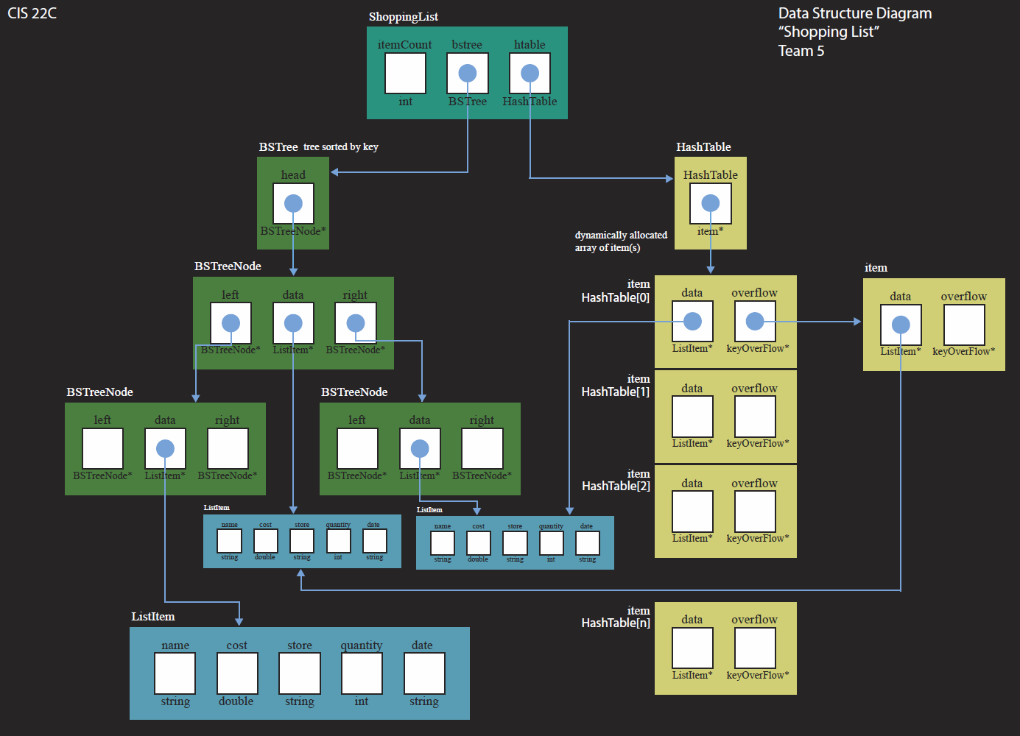
Data Structure Diagram
Notes:
Andrew
anyone prefer this with the dark background like this? i’ve got two different pdfs, one with white background and this one, could submit either
Nicci - I like the dark background more. Going from dark slides to the tables with white backgrounds is a bit blinding in my opinion.

Slide 8
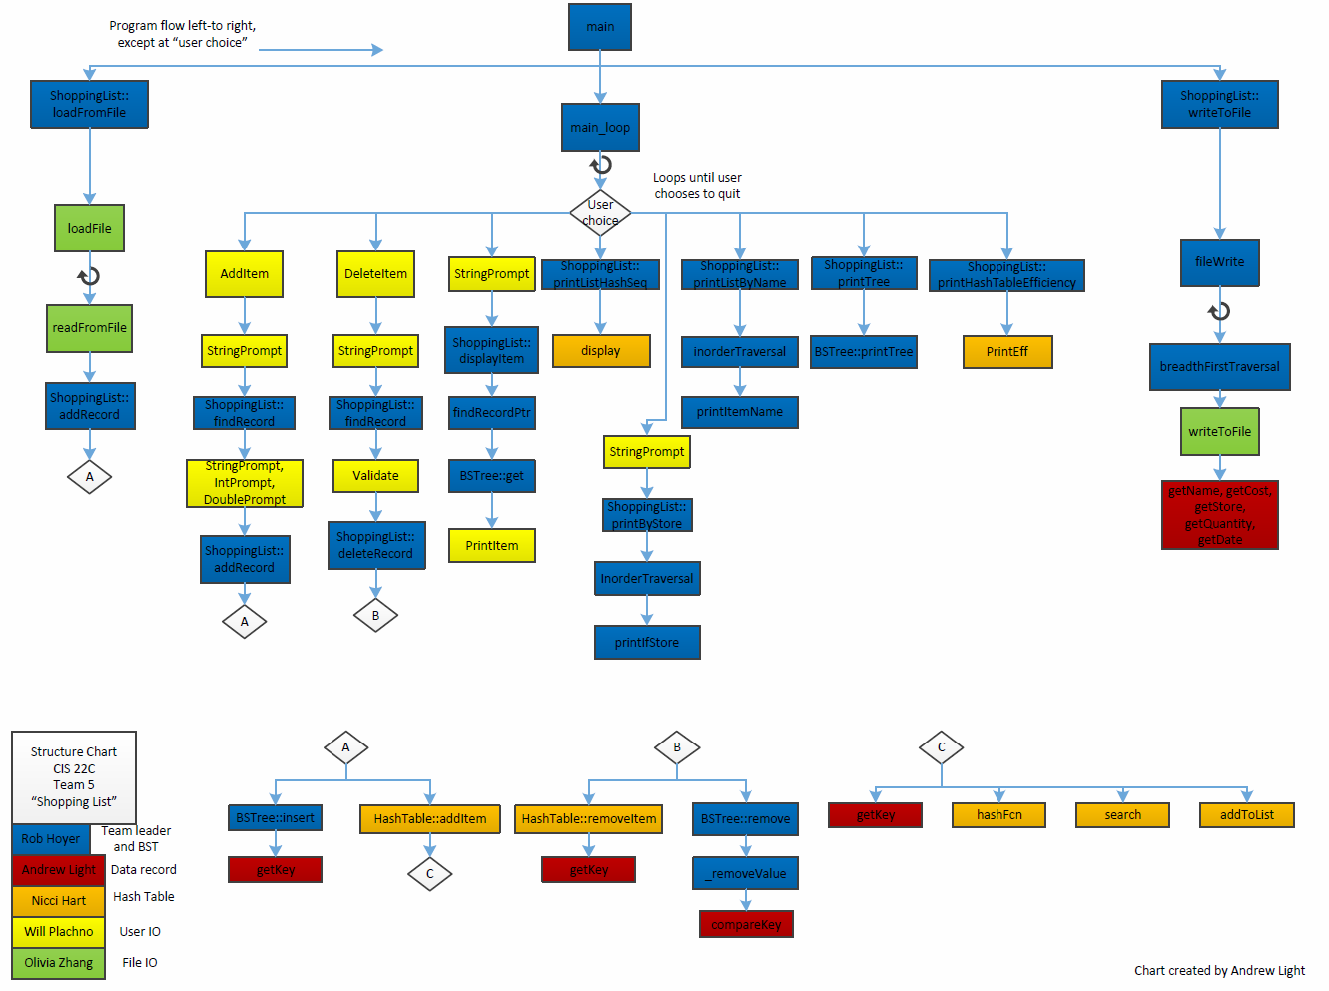
Flow Chart (main)
ok I kinda need the final flowchart before doing this, will update on sunday (spam the shit out of me if i don’t)

Slide 9
ShoppingList
Maintains list of items.
Keeps hash table and bst in sync.
Hash table and bst share allocated data.
Allocates and deallocates records.
Reads data from and writes data to save file.
Notes:
Rob did this right?

Slide 10
Shopping List Interface
ShoppingList();
~ShoppingList();
int loadFromFile(const std::string& fileName);
int writeToFile(const std::string& fileName) const;
bool addRecord(const ListItem& toAdd);
bool deleteRecord(const std::string& name);
bool findRecord(const std::string& name, ListItem& found) const;
int getItemCount() const;
bool exists(const std::string& name) const;
void displayItem(const std::string& item) const;
void printTree() const;
void printListHashSeq() const;
void printListByName() const;
void printHashTableEfficiency() const;
void printByStore(const std::string& storeName) const;
Notes:
Rob

Slide 11
I/O, Save File
Loaf Of Bread
2.37
Safeway
1
every two weeks
Input not case sensitive, same restrictions on variables mentioned before
Notes:
Olivia

Slide 12

User I/O
What is any productivity app without an interface?
Output versus Input
Notes:
Will

Slide 13
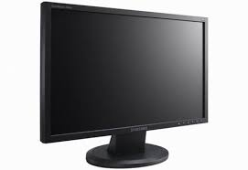
Output
Giving information to the User
Method: Through the screen.
Notes:
Will
maybe remove this slide and simply say something to this effect?

Slide 14
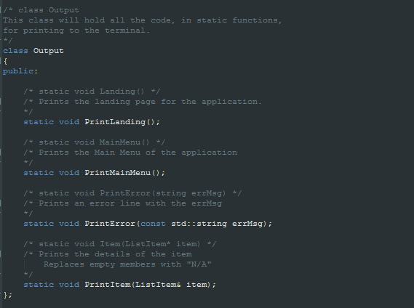
Output Interface
Notes:
Will

Slide 15
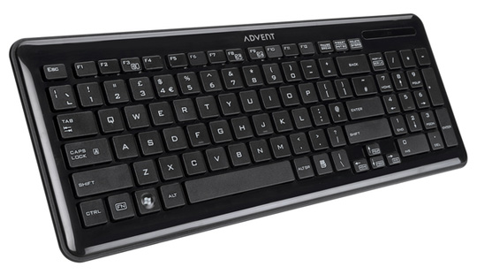
Input
Taking information from the User
Method: Through the keyboard
Three different modes:
Prompts
Menu Choices
Data Input
Notes:
Will
same as above, maybe just remove this slide and say something to this effect

Slide 16
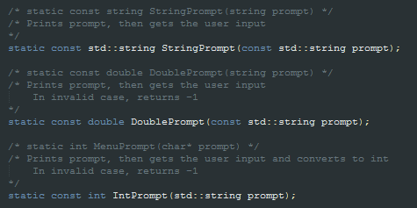

Prompts
Supply a prompt to the user and take in the users reply
Notes:
Will

Slide 17

Menu Choices
Prompts the user for their main menu choice
Repeat until logical choice
Notes:
Will

Slide 18
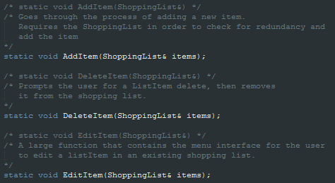
Data Input
Run the user through a series of prompts to achieve data manipulation
Notes:
Will

Slide 19

Moving Forward
A good program is always changing to fit the users needs.
Window-like interface?
Extraction of Data Input into Controller-type class?
Notes:
Will
again, maybe just remove and simply state this

Slide 20
Binary Search Tree
Simple binary search tree. No balancing.
Deals exclusively with allocated data.
Requires the following methods to be implemented by the data class:
int T::compareKey(K keyVal)
T T::getKey()
Iterative insert.
Generic. T = type of record. K = type of key value.
Notes:
Rob

Slide 21
Binary Search Tree Interface
BSTree();
~BSTree();
bool isEmpty() const;
bool insert( T* pNewRecord);
T* remove(const K& targetKey);
T* get(const K& targetKey) const;
void removeAll();
void destroyAll();
void breadthFirstTraversal(const std::function<void(T&)>& visit) const;
void inorderTraversal(const std::function<void(T&)>& visit) const;
void printTree() const;
Notes:
Rob

Slide 22
Binary Search Tree Traversal
void inorderTraversal(const std::function<void(T&)>& visit) const;
-------------------
void printIfStore(ListItem& data, const std::string& comparevalue);
std::string storeName = “Safeway”;
std::function<void(ListItem&)> visitFunc = std::bind(f, std::placeholders::_1, storeName);
inorderTraversal(visitFunc);
Notes:
still Rob

Slide 23
Hash Table
To hash an item, all that is needed is its name.
The key is passed to the hash function and the characters of the key are then used to convert the name into its ASCII value.
Once this is done, the calculated index for the new item is :
Sum of ASCII values of characters in Key
%
The Size of the Hash Table
EX : “BREAD” = (66+82+69+65+68)%25 = 0
Notes:
Nicci
you’ll probably want two or three slides for this

Slide 24
Hash Table - Hash Function
int HTable::hashFcn(const std::string& key)
{
int hash = 0; //the converted string into int (using ASCII)
for(int count = 0; count < key.length(); count++)
{
hash = hash + (int)key[count]; //(int)key converts the characters of the string into ASCII
}
return hash % tableSize;
}

Slide 25
Hash Table Collisions
So what happens when two or more different items have the same index?
The world will end.
...not really.
Notes:
Just a bit of humor. Please let me know if you don’t like it and I’ll remove it.

Slide 26
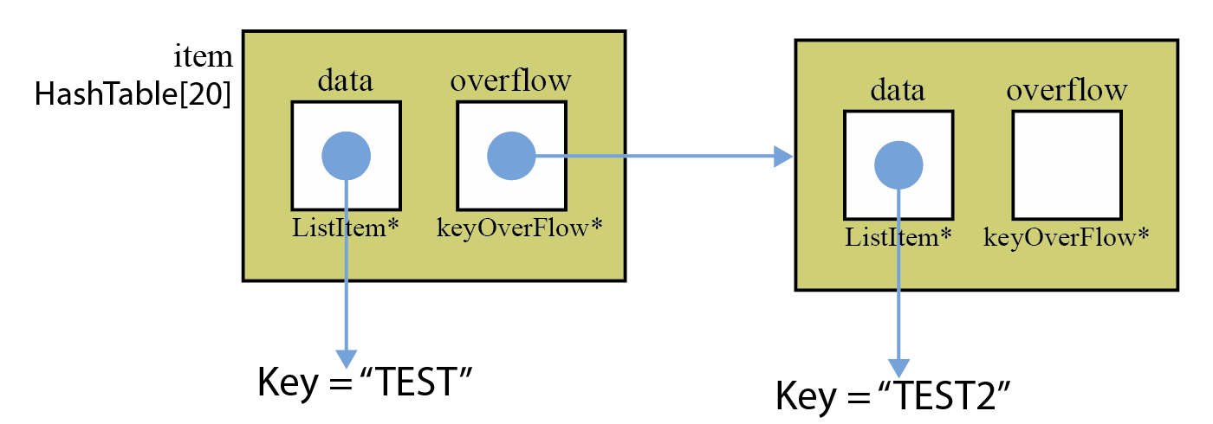
Collisions
When the program detects that an item already exists at the index it is adding to, it will resolve using a linked list:
Compare the key existing at the index to the new item’s key
The item with the larger value will be pushed into the linked list of the index called “Overflow”.
Entire overflow list is sorted from least to greatest by key
Notes:
bullet point that was here before:
If there’s an item already existing in the overflow list, the program will do the same as it did before. (compare the keys, push the larger item into the smaller item’s overflow.)

Slide 27
Demo
Notes:
probably someone who isn’t rob, since he’s said like half the presentation at this point

